Slide 1
Lecture #3: Introducing C++
Roshan Manjushree Adhikari
Computer Science
May 7, 2018

Slide 2
Today’s agenda
Introduction
A sample C++ program
Reference variables
Inline functions

Slide 3
What is C++
An OOP language developed by Bjarne Stroustrup at AT&T Bell Laboratories in early 1980s.
Commbination of Simula67 and C.
C++ is a superset of C. So, most of what you know about C applies to C++ too. Initially called ‘C with classes.’
Additions: classes, inheritance, function overloading and operartor overloading.

Slide 4
First C++ program
#include<iostream>
using namespace std;
int main()
{
cout << "Hello World"; //sample comment return 0;
}
main function
statmetents
Notes:
Most statements tells compiler to do something.

Slide 5
How to compile your first program?
Save the source code with extension .cpp
Open linux terminal.
Enter the commands:
g++ filename.cpp
./a.out
Notes:
main() function

Slide 6
Statements
Fundamental unit of C++ programming.
Tells the compiler to do something.
Seicolon(;) ends an statement in C++ and C.

Slide 7
Variables
Variables are the names you give to computer memory locations which are used to store values in a computer program.
name + value

Slide 8
Output operator
Note the two new things in the program: cout and <<.
Identifier cout is a predefined object that represents the standard output stream in C++.
<< is called insertion or put to operator.
<< sends the contents of the variable on its right to the object on its left.

Slide 9
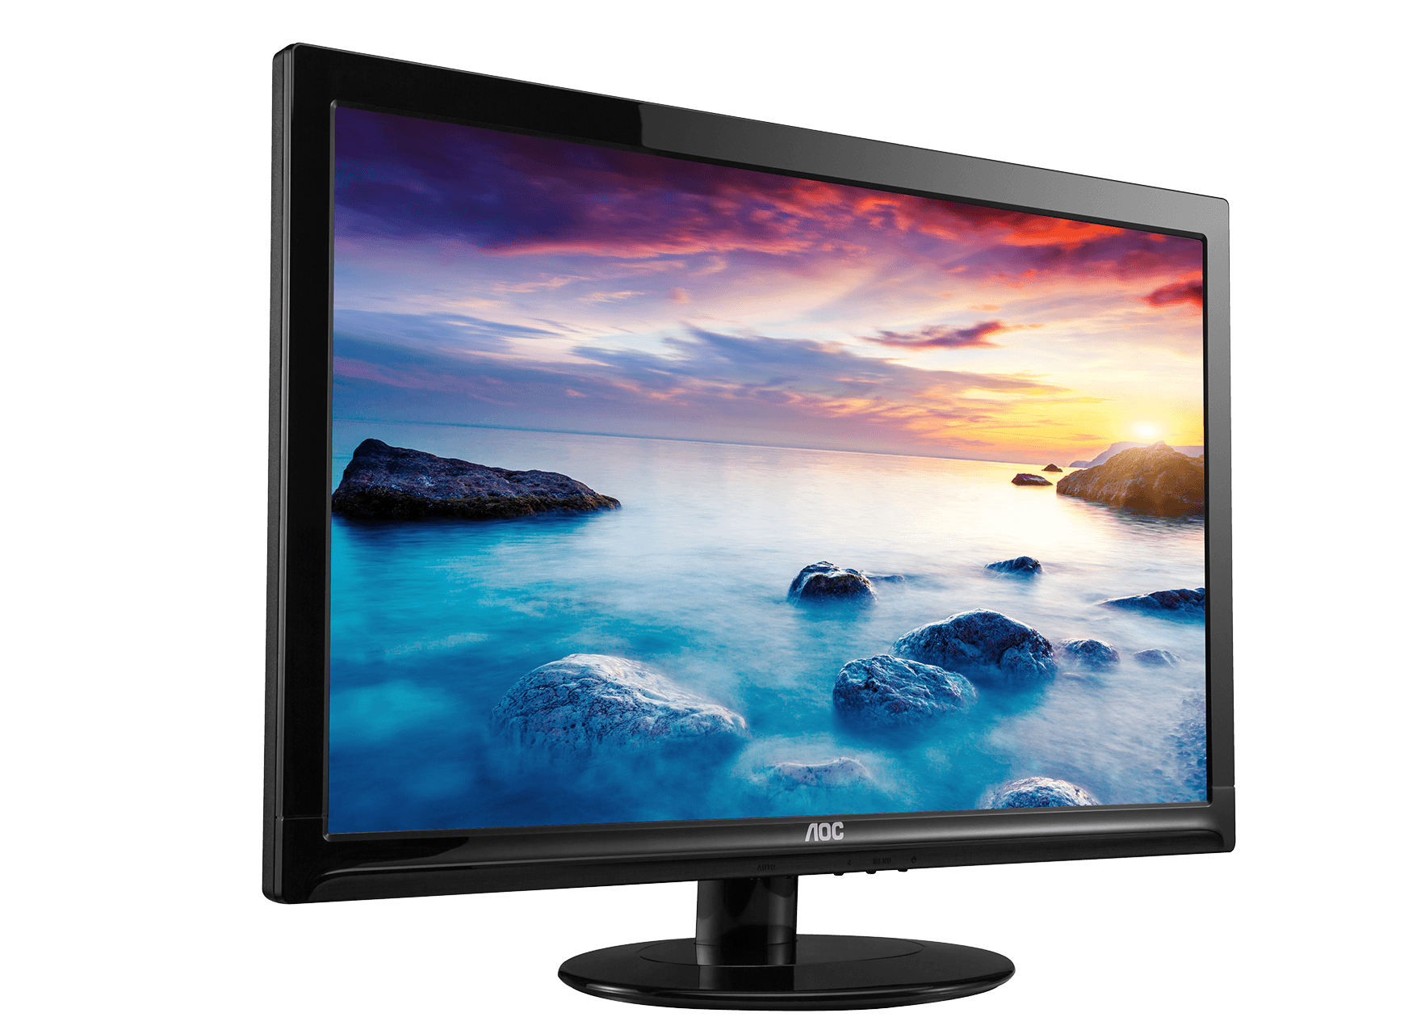
Screen
<<
cout
Hello World
Fig: Output using insertion operator

Slide 10
Preprocessor directive
The first line of your program
#include<iostream>
is actually a preprocessor directive, not a statement.
Preprocessor part of the compiler deals with these directives before it begins th real compilation process.
#include tells the compiler to insert another file into your source file. IOSTREAM is am example of header file.
Notes:
Two lines that begin are called directives.
Preprocessor + using

Slide 11
The using directive
A C++ program can be divided into different namespaces.
Namespace defines a scope for the identifiers that are used in the program.
Namespaces allow us to group named entities that otherwise would have global scope into narrower scopes, giving them namespace scope.
Used to avoid naming conflicts.
std is the namespace where ANSI C++ standard class libraries are defined.
Notes:
init() in C language.

Slide 12
Comments
Two ways to comment your code.
Single line and multiline line
//This is an example of
//C++ program to print
//Hello world on screen
/*This is an example of
C++ program to illustrate
some of its features */
Notes:
Statements + Variables

Slide 13
Define integer variables in C++ program
#include<iostream>
using namespace std;
int main()
{
int var1, var2;
var1 = 20;
var2 = var1 + 10;
cout << "var1 + 10 is ";
cout << var2 << endl;
return 0;
}

Slide 14
Input operator
cin operator.
Causes the program to wait and resulting number is placed in a variable.
For example:
cin >> temp
>> is the extraction or get from operator.

Slide 15

Object
Extraction operator
Variable
>>
cin
23.4
Fig: Input using extraction operator

Slide 16
#include<iostream>
using namespace std;
int main()
{
int temp;
cout << "Enter a number : ";
cin >> temp;
cout << "The number you entered is : ";
cout << temp << endl;
return 0;
}

Slide 17
Quick Work
WAP to compute quotient and remainder dividing two input numbers.

Slide 18
Cascading of I/O operators
<< can be reprated in cout statement.
For example :
cout << “Sum = ” << sum << “\n”;
cin >> number1 >> number2

Slide 19
An Example with class
#include<iostream>
using namespace std;
class person
{
private:
char name[50];
int age;
public:
void setAge(int x)
{
age = x;
}
int getAge()
{
return age;

Slide 20
}
};
int main()
{
person jack,john;
jack.setAge(40);
cout << "Jack is " << jack.getAge()<< " years old.";
return 0;
}

Slide 21
References in C++
Reference variable is an alias, another name for an already existing variable.
Once a reference is initialized with a variable, either the variable name or the reference name may be used to refer to the variable.
Reference is ALMOST same as POINTERS but.....
You cannot have NULL references. You must always be able to assume that a reference is connected to a legitimate piece of storage.
Once a reference is initialized to an object, it cannot be changed to refer to another object. Pointers can be pointed to another object at any time.
A reference must be initialized when it is created. Pointers can be initialized at any time.

